Slide 1

Injection Day #2
https://github.com/daniel-leicht/PythonInjection

Slide 2
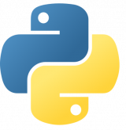
- Last week exercises
- List & dict comprehensions
- Exceptions in Python
- Reading & writing to files - Modules & namespace imports - Python’s standard library - External packages & pip - Final project

Slide 3
- Last week exercises
- List & dict comprehensions
- Exceptions in Python
- Reading & writing to files - Modules & namespace imports - Python’s standard library - External packages & pip - Final project

Slide 4
List & dict comprehensions
Comprehensions are simply one line for loops that result in the building of a list
A good list comprehension can make your code more expressive and actually easier to read
Every list comprehension can be rewritten as a for loop but not every for loop can be rewritten as a list comprehension
Conditional expressions can be added to filter iterations
Works on both lists & dicts.

Slide 5
- Last week exercises
- List & dict comprehensions
- Exceptions in Python
- Reading & writing to files - Modules & namespace imports - Python’s standard library - External packages & pip - Final project

Slide 6
Exceptions
The Python interpreter and Python programs use exceptions to reports errors.
An unhandled exception will cause the interpreter to terminate the program and print the exception data.
Catching and handling exceptions is done by try-except statements.
We can also raise exceptions by using the `raise` statement.
Python exceptions are objects that inherit from the Exception class

Slide 7
- Last week exercises
- List & dict comprehensions
- Exceptions in Python
- Reading & writing to files - Modules & namespace imports - Python’s standard library - External packages & pip - Final project

Slide 8
Reading & Writing To Files
To access a certain file in Python we use open(“path_to_file”, “mode”) which returns a file object.
Mode can be either “r”, “w” or “a” for read, write or append, if no mode is specified, the default is “r”. (there are more but we’ll leave it at that for now).
File objects have many different functions to give the developer access to the opened file, the most useful and common ones are write() and read().
Trying to open a file can result in errors (such as file does not exist) and an exception will be thrown.
It is important to close file objects once we’re done with them. (Why?)

Slide 9
- Last week exercises
- List & dict comprehensions
- Exceptions in Python
- Reading & writing to files - Modules & namespace imports - Python’s standard library - External packages & pip - Final project

Slide 10
Modules & namespace imports
To make use of the classes, functions and variables in other modules, we’ll need to import it’s namespace into our namespace.
Importing a module is done using the import or from-import statements.
When importing a module the interpreter does the following:
1) Executes the module that was imported.
2) Imports the module’s namespace into our current namespace.
Python will look for modules in the folders specified in the environment variable PYTHONPATH.
We can import a module and give it an alias using the as keyword.

Slide 11
- Last week exercises
- List & dict comprehensions
- Exceptions in Python
- Reading & writing to files - Modules & namespace imports - Python’s standard library - External packages & pip - Final project

Slide 12
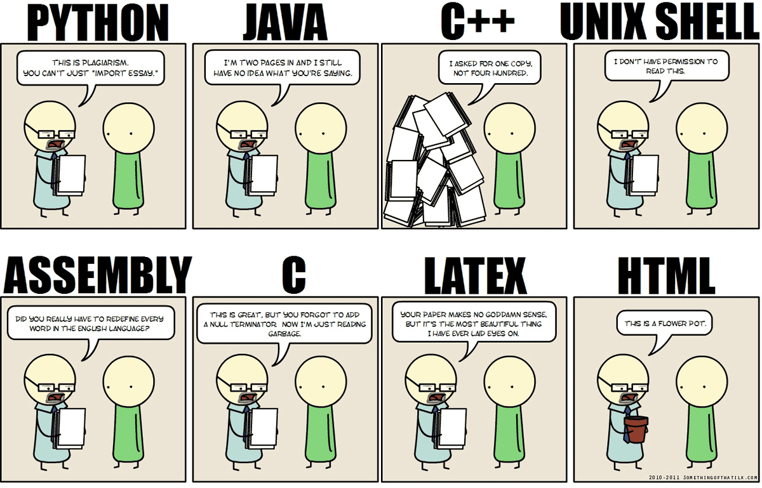
Python’s standard library

Slide 13
Python’s standard library
Python’s standard library is very extensive, offering a wide range of facilities and utilities.
The standard library comes built-in with every Python installation (although some are only provided for certain operating systems)
Full library documentation can be found at https://docs.python.org/3/library/
There are dozens of modules in the standard library, but we’ll go over some chosen few.

Slide 14
Python’s standard library - MATH
math module – this module has all the functions that your Casio calculator had and more.
Contains mostly: power and logarithmic, trigonometric, hyperbolic and number-theory functions.
Also contains Pi, E & Tau constants.

Slide 15
Python’s standard library - Statistics
statistics module - provides functions for calculating mathematical statistics.
Used to calculate:
Different types of mean (average) and median values.
Different types of deviations and variance.

Slide 16
Python’s standard library - RANDOM
random module - pseudo-random number generators for various distributions.
Has the ability to generate random integers, perform random actions on sequences (such as shuffle, choose, or sample).
Can return random numbers on different distributions.

Slide 17
Python’s standard library - TIME
time module - various time-related functions.
More related to the OS and CPU time functions rather than human readable time.
Provides utilities for OS timestamps, computer clock, and program sleep (delay).

Slide 18
Python’s standard library - DATETIME
datetime module - supplies classes for manipulating dates and times in both simple and complex ways.
Exposes six classes, each with different uses and utilities:
date
time
datetime
timedelta
tzinfo
timezone

Slide 19
Python’s standard library - URLLIB
urllib module – used for opening and reading URLs over HTTP, and parsing URL addresses.
Useful for simple crawling and data mining.
Exposes three main classes:
request
parse
error

Slide 20
Python’s standard library - json
json module – convert python data JSON strings and vice-versa.
dumps() function will take a python data structure and return a JSON string representing it.
loads() will takes a JSON string and converts it to native Python data type.
dump() and load() will do the same but operate on file objects instead of strings.
Not every Python data-type can be converted to JSON, but any JSON string can be converted to Python data-type.

Slide 21
Python’s standard library - string
string module – more useful string utilities
Has many useful constant strings (such as all possible digits, all possible letters, all possible punctuation marks, etc…)
Also useful for string templating

Slide 22
Python’s standard library - OS
os module – Used for all OS related tasks, such as file operations and running processes.
Has the path sub-module for many path related operations (check if a path is a file/folder/exists, join paths, etc…)
Run command line operations - os.system(“dir c:\\windows”)

Slide 23
- Last week exercises
- List & dict comprehensions
- Exceptions in Python
- Reading & writing to files - Modules & namespace imports - Python’s standard library - External packages & pip - Final project

Slide 24
External packages & pip Package manager
PIP is a package manager for Python packages/modules.
PIP’s library consists of thousands of useful modules (Python code libraries you can include in your project).
PIP comes built-in with Python 3+

Slide 25
External packages & pip Package manager
Installing a package: “pip install loremipsum”
Installing a specific version of a package: “pip install loremipsum==1.0.5”
Removing a package from my Python installation: “pip uninstall loremipsum”
Using an installed package? just import and use it:
import loremipsum
print(loremipsum.generate_paragraph())

Slide 26
ML Workshop Required Modules
matplotlib: 2.2.2
tensorflow: 1.11.0
sklearn: 0.20.1
scipy: 1.1.0
pandas: 0.23.0
numpy: 1.14.3
jupyter

Slide 27
- Last week exercises
- List & dict comprehensions
- Exceptions in Python
- Reading & writing to files - Modules & namespace imports - Python’s standard library - External packages & pip - Final project

Slide 28
Final Project
We learned a new ML prediction algorithm, and we now want to test it on Bitcoin and get rich!
Our tasks are:
Automatically retrieve the closing Bitcoin / USD rate for each of the last 30 days.
Calculate the variance, standard deviation and average rate of the last 30 closing rates.
Assume that we bought 1 BTC in each of the last 30 days (using the closing rate), and sold all 30 of them right now, print our profit or loss. Assume that there is a buy and sell fees of 2%.
Print the above collected data, and save that information to a new file. The filename should contain the current date, so we can use it in the future for analysis.
* Use https://www.coindesk.com/api to retrieve BTC/USD rates.

Slide 29
Some Remaining Subject
Classes and inheritance
Lambdas
Python memory management
Organizing Python projects

